Slide 1
RecyclerView
Day 6 Part II

Slide 2
Contents
RecyclerView Components
Implementing a RecyclerView

Slide 3
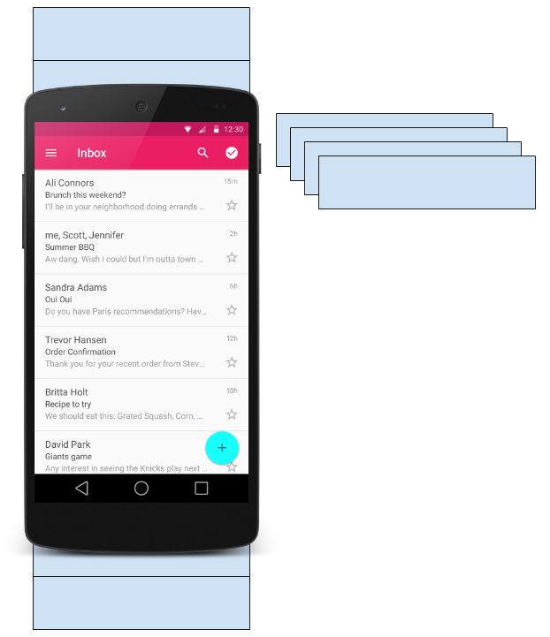
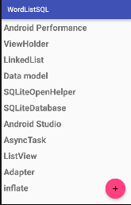
What is a RecyclerView?
RecyclerView is scrollable container for large data sets
Efficient
Uses and reuses limited number of View elements
Updates changing data fast

Slide 4
RecyclerView Components

Slide 5
Data
RecyclerView scrolling list for list items—RecyclerView
Layout for one item of data—XML file
Layout manager handles the organization of UI components in a View—Recyclerview.LayoutManager
Adapter connects data to the RecyclerView—RecyclerView.Adapter
ViewHolder has view information for displaying one item—RecyclerView.ViewHolder

Slide 6
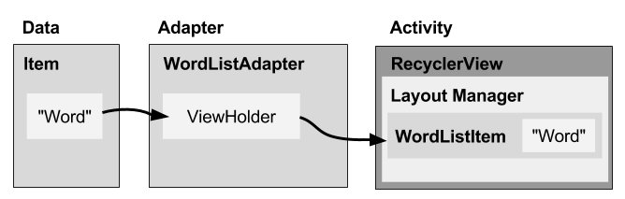
How components fit together overview

Slide 7
What is a layout manager?
Each ViewGroup has a layout manager
Use to position View items inside a RecyclerView
Reuses View items that are no longer visible to the user
Built-in layout managers
LinearLayoutManager
GridLayoutManager
StaggeredGridLayoutManager
For RecyclerView, extend RecyclerView.LayoutManager

Slide 8
What is an adapter?
Helps incompatible interfaces work together
Example: Takes data from database Cursor and prepares strings to put into a View
Intermediary between data and View
Manages creating, updating, adding, deleting View items as underlying data changes
RecyclerView.Adapter

Slide 9
What is a ViewHolder?
Used by the adapter to prepare one View with data for one list item
Layout specified in an XML resource file
Can have clickable elements
Is placed by the layout manager
RecyclerView.ViewHolder

Slide 10
Implementing RecyclerView

Slide 11
Steps Summary
Add RecyclerView dependency to build.gradle if needed
Add RecyclerView to layout
Create XML layout for item
Extend RecyclerView.Adapter
Extend RecyclerView.ViewHolder
In Activity onCreate(), create RecyclerView with adapter and layout manager

Slide 12
Add dependency to app/build.gradle
Add RecyclerView dependency to build.gradle if needed:
dependencies {
...
compile 'com.android.support:recyclerview-v7:26.1.0'
...
}

Slide 13
Add RecyclerView to XML Layout
<android.support.v7.widget.RecyclerView
android:id="@+id/recyclerview"
android:layout_width="match_parent"
android:layout_height="match_parent">
</android.support.v7.widget.RecyclerView>

Slide 14
Create layout for 1 list item
<LinearLayout …>
<TextView
android:id="@+id/word"
style="@style/word_title" />
</LinearLayout>

Slide 15
Implement the adapter
public class WordListAdapter
extends RecyclerView.Adapter<WordListAdapter.WordViewHolder> {
public WordListAdapter(Context context,
LinkedList<String> wordList) {
mInflater = LayoutInflater.from(context);
this.mWordList = wordList;
}
}

Slide 16
Adapter has 3 required methods
onCreateViewHolder()
inBindViewHolder()
getItemCount()
Let's take a look!

Slide 17
onCreateViewHolder()
@Override
public WordViewHolder onCreateViewHolder( ViewGroup parent, int viewType) {
// Create view from layout
View mItemView = mInflater.inflate(
R.layout.wordlist_item, parent, false);
return new WordViewHolder(mItemView, this);
}

Slide 18
onBindViewHolder()
@Override
public void onBindViewHolder( WordViewHolder holder, int position) {
// Retrieve the data for that position
String mCurrent = mWordList.get(position);
// Add the data to the view
holder.wordItemView.setText(mCurrent);
}

Slide 19
getItemCount()
@Override
public int getItemCount() {
// Return the number of data items to display
return mWordList.size();
}

Slide 20
Create the view holder in adapter class
class WordViewHolder extends RecyclerView.ViewHolder { //.. }
If you want to handle mouse clicks:
class WordViewHolder extends RecyclerView.ViewHolder
implements View.OnClickListener { //.. }

Slide 21
View holder constructor
public WordViewHolder(View itemView, WordListAdapter adapter) {
super(itemView);
// Get the layout
wordItemView = itemView.findViewById(R.id.word);
// Associate with this adapter
this.mAdapter = adapter;
// Add click listener, if desired
itemView.setOnClickListener(this);
}
// Implement onClick() if desired

Slide 22
Create the RecyclerView in Activity onCreate()
mRecyclerView = findViewById(R.id.recyclerview);
mAdapter = new WordListAdapter(this, mWordList);
mRecyclerView.setAdapter(mAdapter);
mRecyclerView.setLayoutManager(new
LinearLayoutManager(this));

Slide 23
Practical: RecyclerView
This is rather complex with many separate pieces. So, there is a whole practical where you implement a RecyclerView that displays a list of clickable words.
Shows all the steps, one by one with a complete app

Slide 24
END

